Slide 1
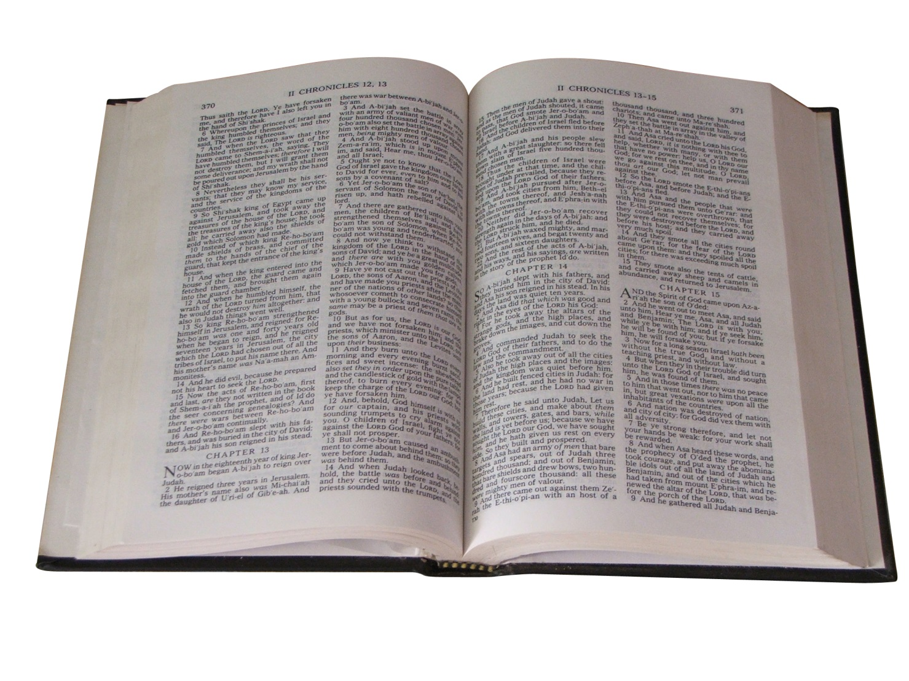
Bible Study Rules
How to properly approach our study of God’s word.

Slide 2
Some Bible Study Rules:
Remember you are reading the inspired word of God.
Be fully prepared to change when demanded.
Ask, “Who is speaking?”
Ask, “Who is being spoken to?”
Read the context.
Read all on a given subject.
Seek the application in your life.

Slide 3
Questions to Ask…
Is there an example to follow?
Is there a sin to avoid?
Is there a promise to accept?
Is there a prayer to repeat?
Is there a command to obey?
Is there a condition to meet?
Is there a verse to memorize?
Is there an error to mark?
Is there a challenge to face?

Slide 4
Always…
Read thoughtfully.
Read repeatedly.
Read patiently.
Read imaginatively.
Read meditatively.

