Slide 1
The Minor Prophets
Joel

Slide 2
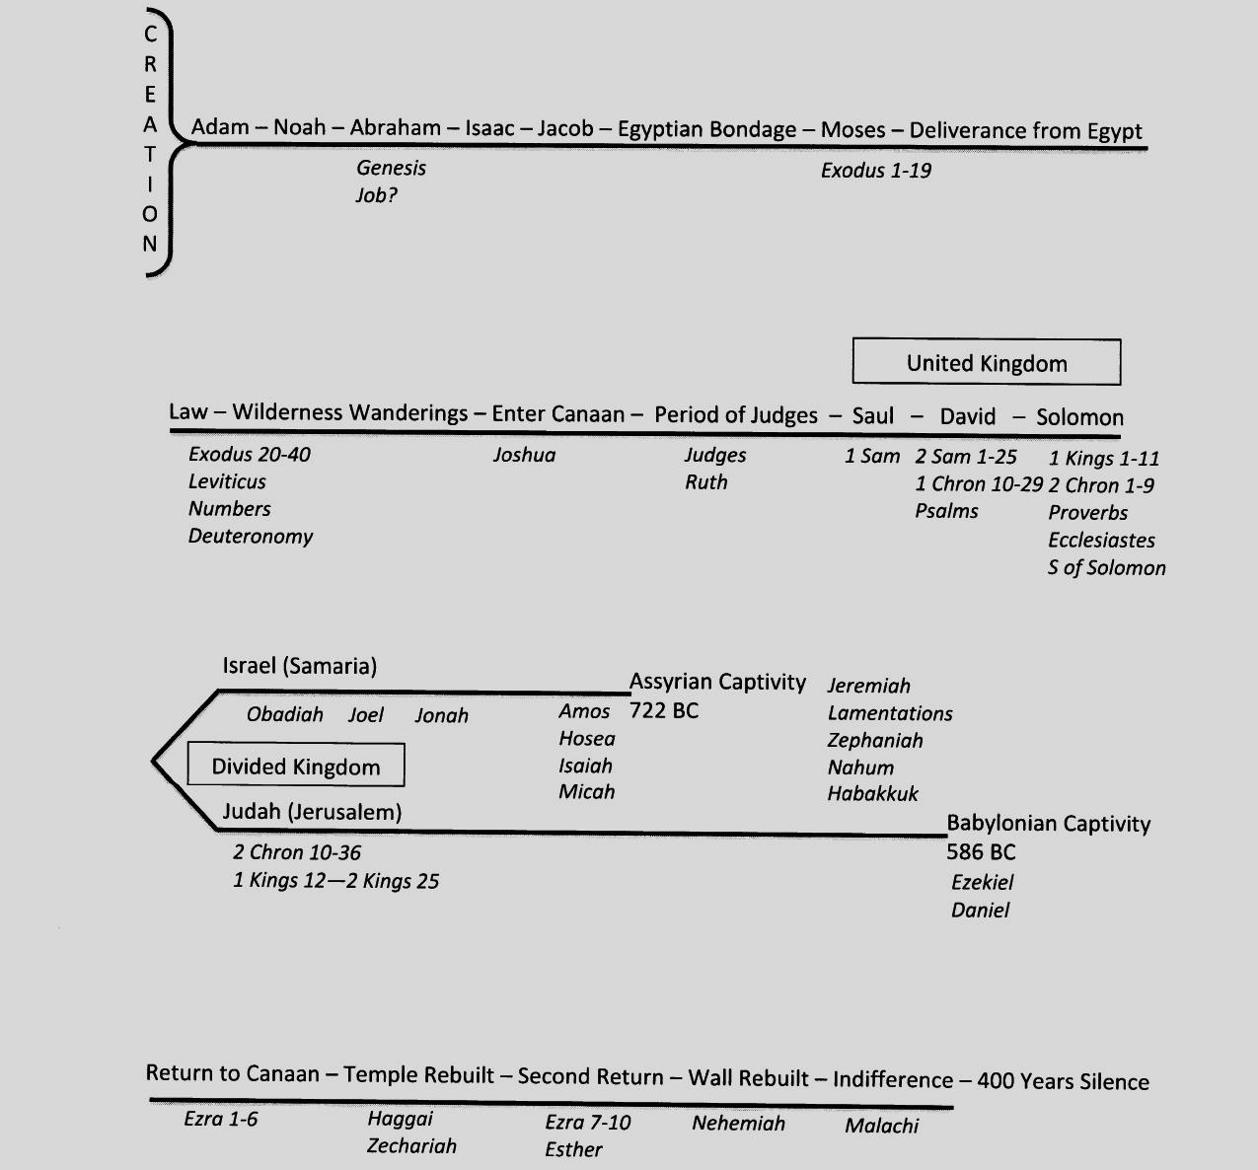
Old Testament Timeline

Slide 3
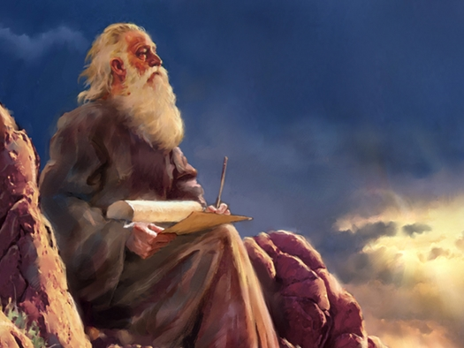
Joel
Name means “Jehovah is God.”
Called the “Prophet of Pentecost.”
All we know of Joel is what we find in the book that bears his name.
Most likely as citizen of Judah.

Slide 4
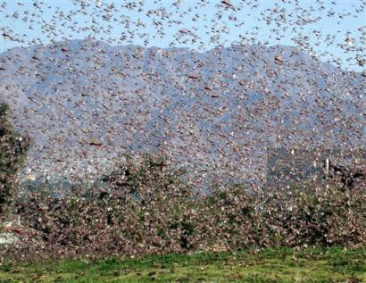
Joel: The Day of The Lord

Slide 5
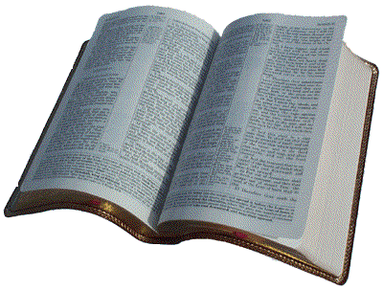
The word of the LORD that came to Joel, the son of Pethuel:
Joel 1:1

Slide 6
Hear this, you elders; give ear, all inhabitants of the land! Has such a thing happened in your days, or in the days of your fathers?
Joel 1:2

Slide 7
Tell your children of it, and let your children tell their children, and their children to another generation.
Joel 1:3

Slide 8
What the cutting locust left, the swarming locust has eaten. What the swarming locust left, the hopping locust has eaten, and what the hopping locust left, the destroying locust has eaten.
Joel 1:4

Slide 9
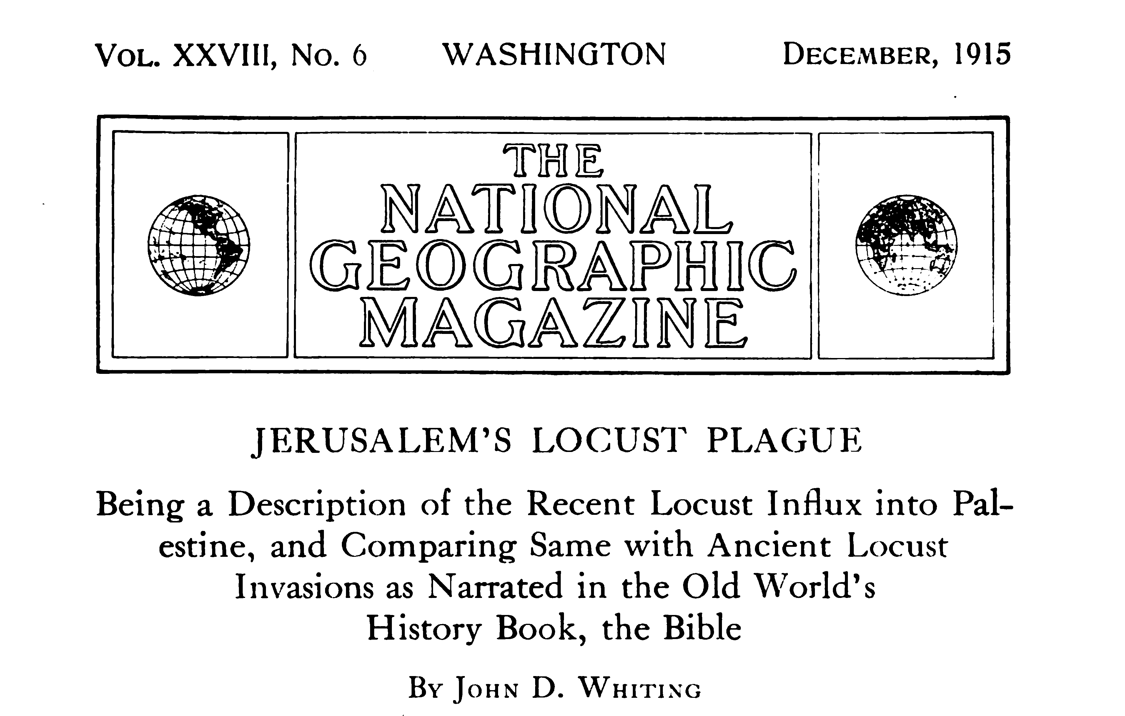

Slide 10
Thus they pass through several moults, of which, however, but three stages are plainly distinguishable—the larva or wingless stage, the pupa, with small wings, or properly wing sacks developing, and the full-fledged flying locust.
Whiting, 522

Slide 11
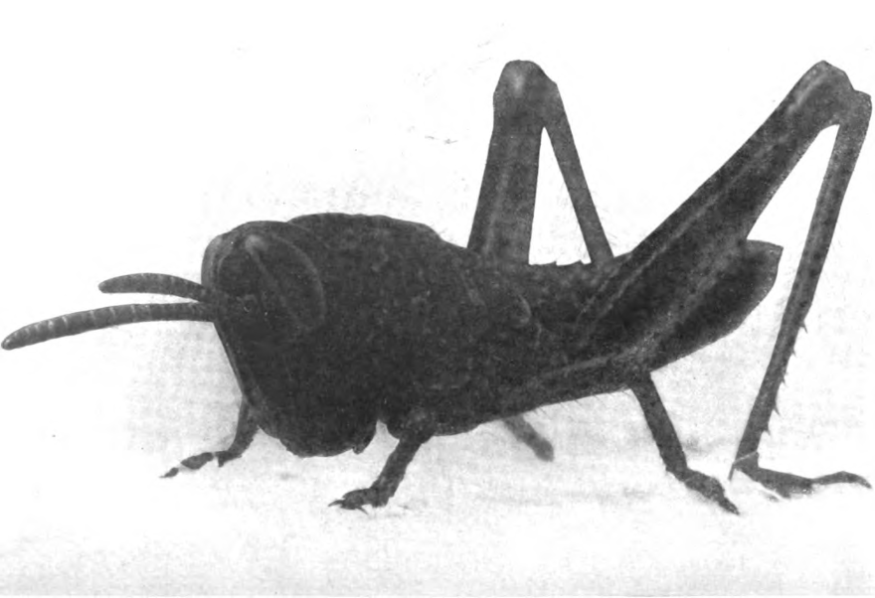
Thus they pass through several moults, of which, however, but three stages are plainly distinguishable—the larva or wingless stage, the pupa, with small wings, or properly wing sacks developing, and the full-fledged flying locust.
Whiting, 522

Slide 12
Thus they pass through several moults, of which, however, but three stages are plainly distinguishable—the larva or wingless stage, the pupa, with small wings, or properly wing sacks developing, and the full-fledged flying locust.
Whiting, 522

Slide 13
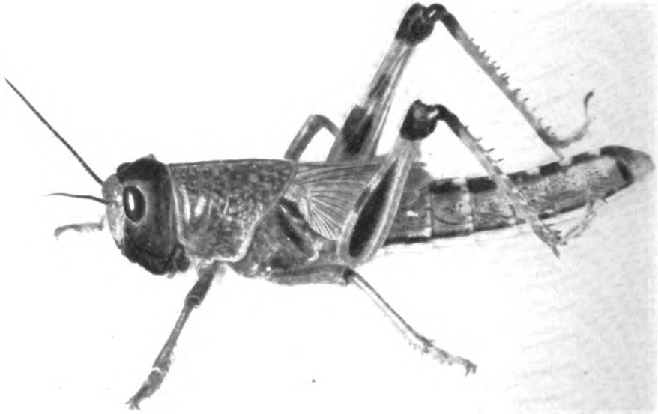
Thus they pass through several moults, of which, however, but three stages are plainly distinguishable—the larva or wingless stage, the pupa, with small wings, or properly wing sacks developing, and the full-fledged flying locust.
Whiting, 522

Slide 14
Thus they pass through several moults, of which, however, but three stages are plainly distinguishable—the larva or wingless stage, the pupa, with small wings, or properly wing sacks developing, and the full-fledged flying locust.
Whiting, 522

Slide 15
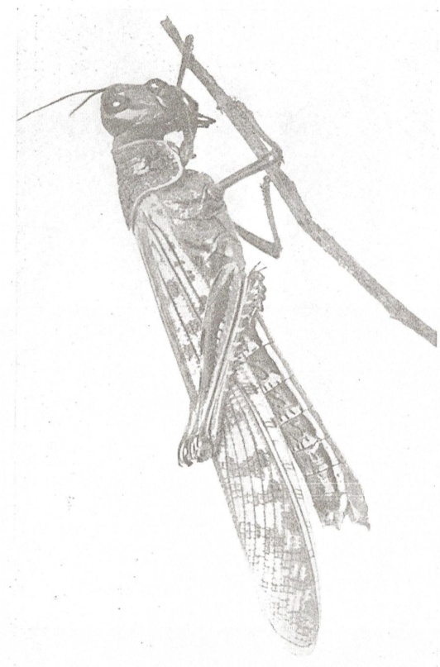
Thus they pass through several moults, of which, however, but three stages are plainly distinguishable—the larva or wingless stage, the pupa, with small wings, or properly wing sacks developing, and the full-fledged flying locust.
Whiting, 522

Slide 16
For a nation has come up against my land, powerful and beyond number; its teeth are lions' teeth, and it has the fangs of a lioness. It has laid waste my vine and splintered my fig tree; it has stripped off their bark and thrown it down; their branches are made white.
Joel 1:6-7

Slide 17
Once entering a vineyard, the sprawling vines would in the shortest time be nothing but bare bark, the long dark stems lying flat on the ground, much resembling snakes.
Whiting, 529

Slide 18
Fig leaves perhaps of all things best suited their taste, and when once a tree fell a prey to them the ground would be literally layers deep, and the trunk so covered with crawlers as to make it a bright yellow color. On every leaf dozens would be perched.
Whiting, 529

Slide 19
They first ate away the tender parts, leaving a perfect skeleton of the large broad leaves. But soon these, too, were devoured, and usually after one day’s work the tree stood naked of any leaves, with nothing but the hard unripe fruit protruding stiffly from the branches.
Whiting, 529

Slide 20
When the daintier morsels were gone the bark was eaten off the young topmost branches, which, after exposure to the sun, bleached snow-white.
Whiting, 529

Slide 21
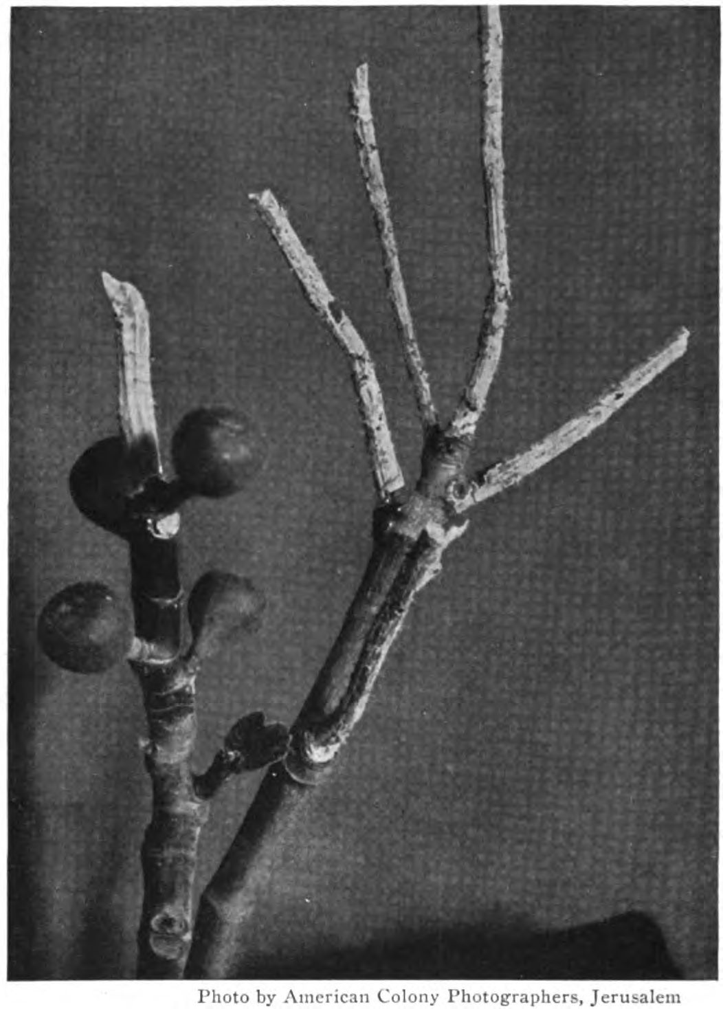

Slide 22
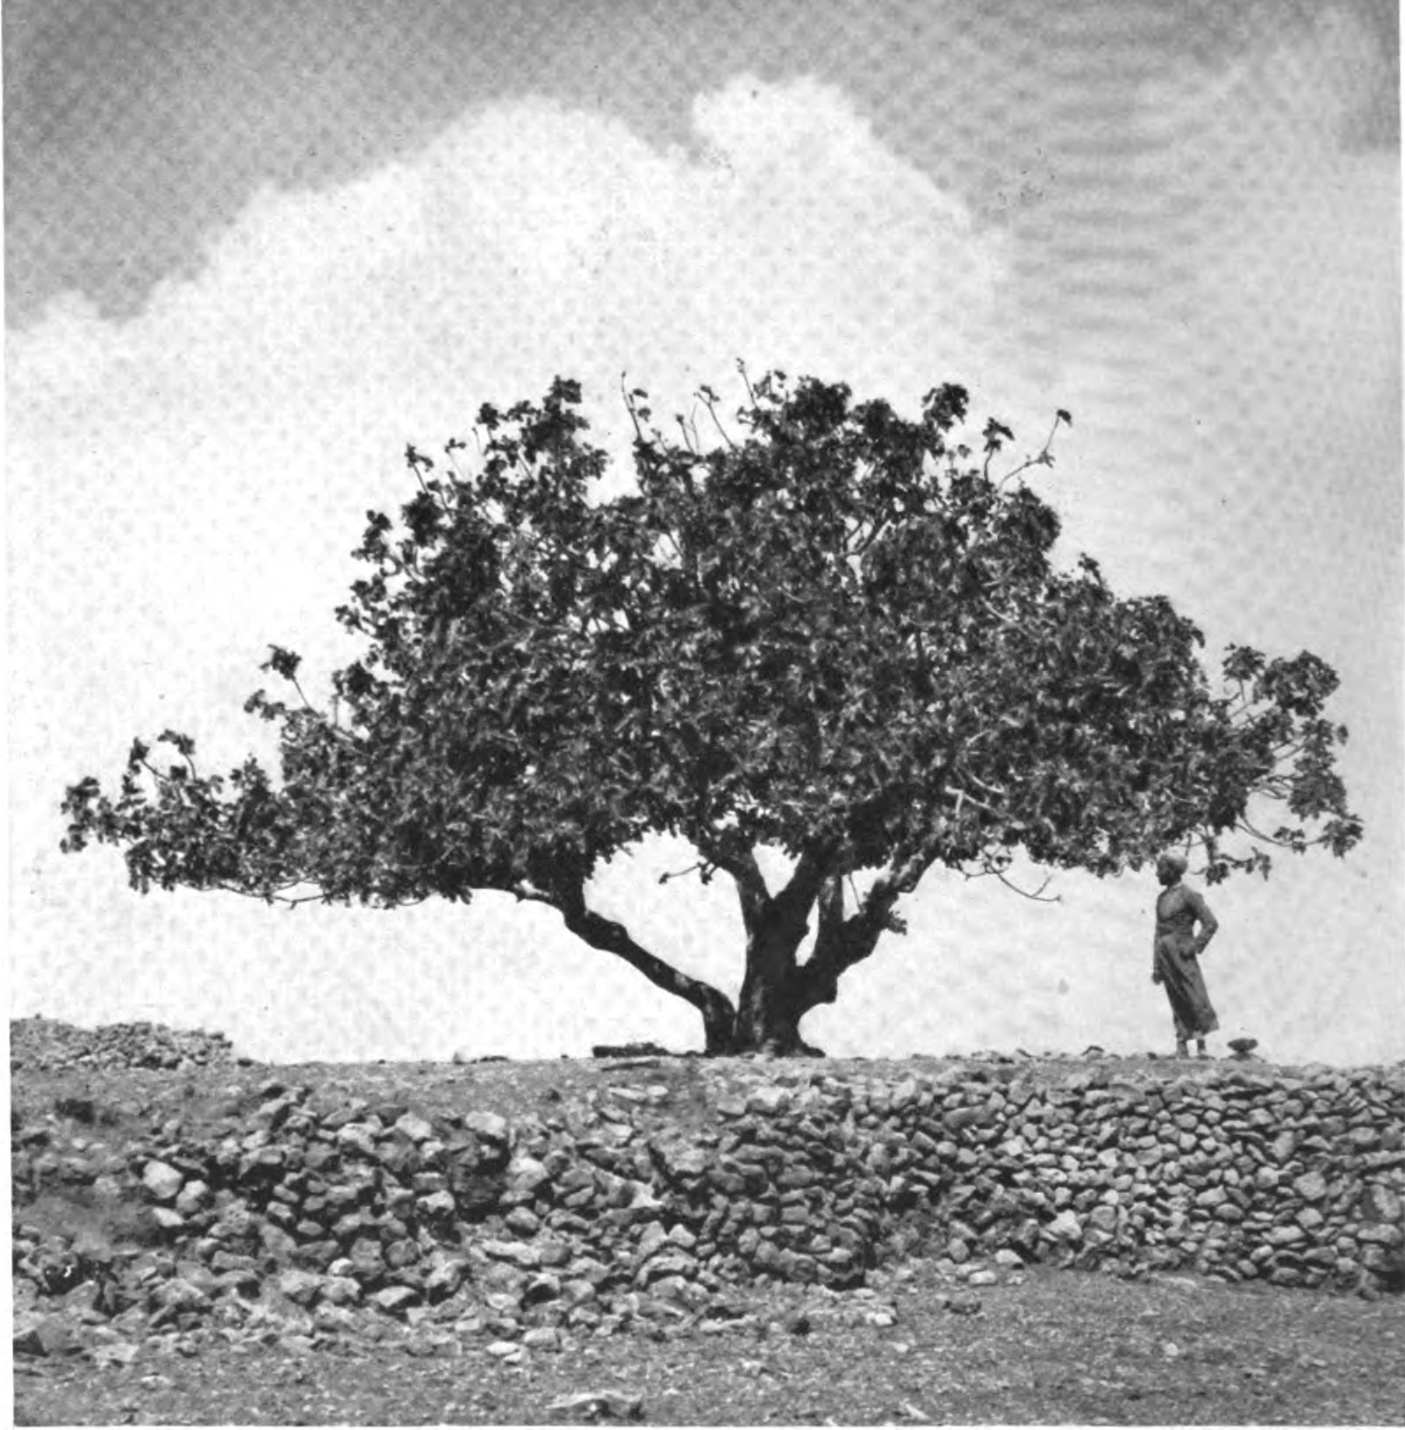

Slide 23
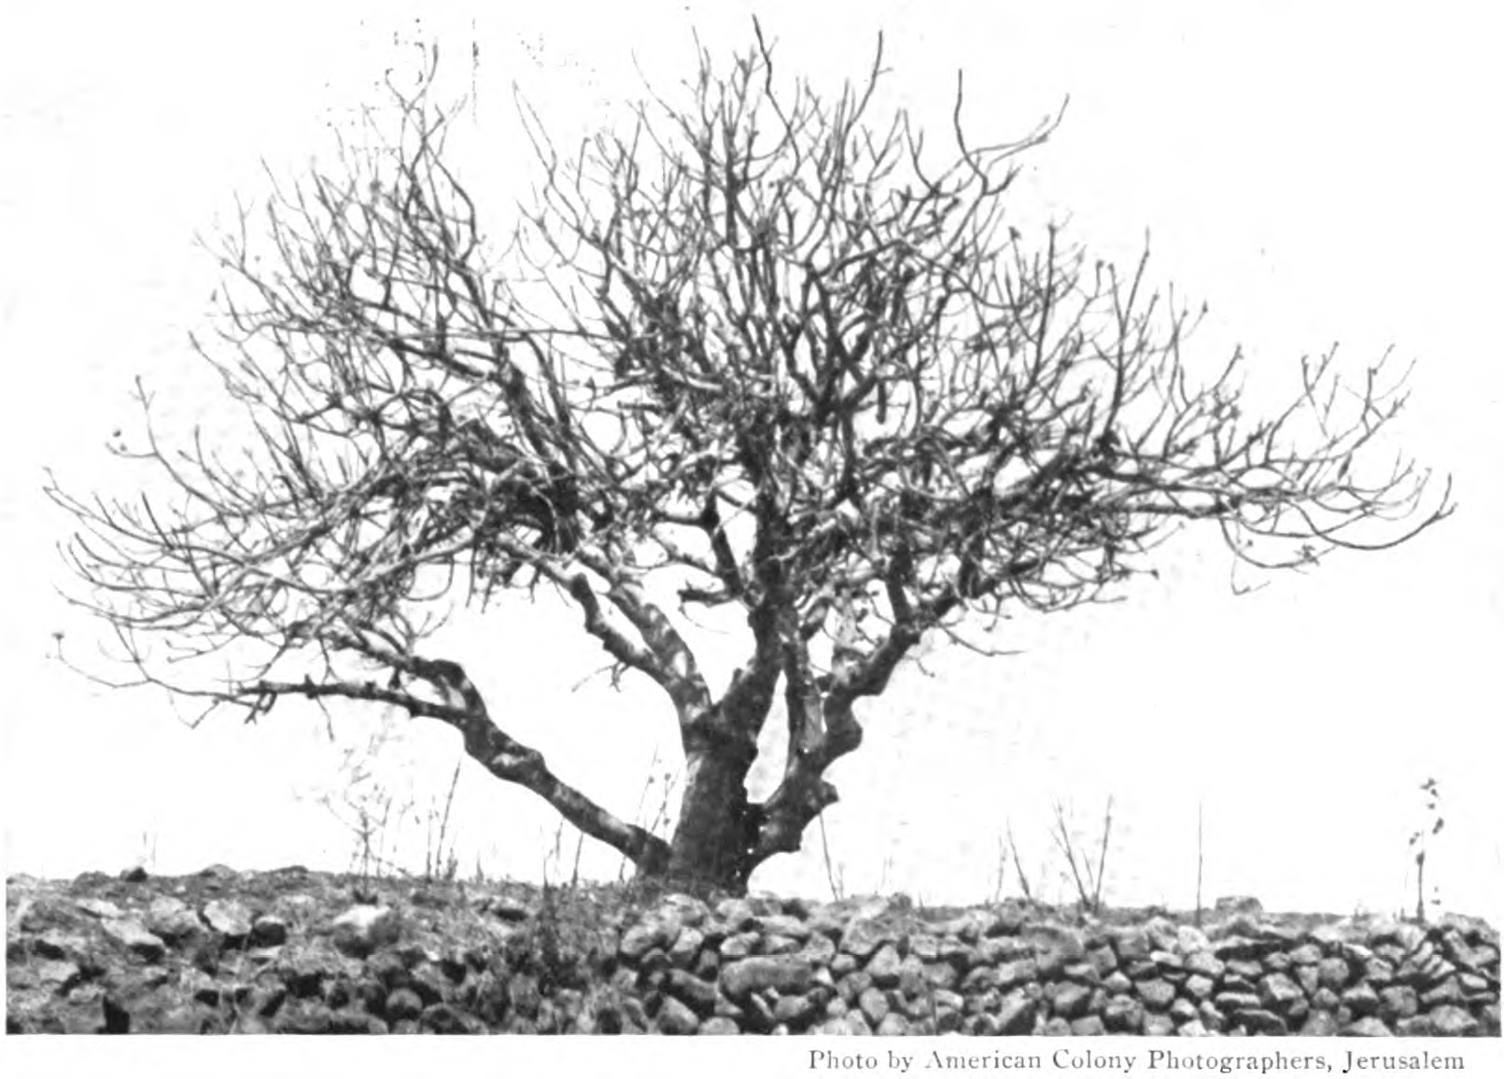

Slide 24
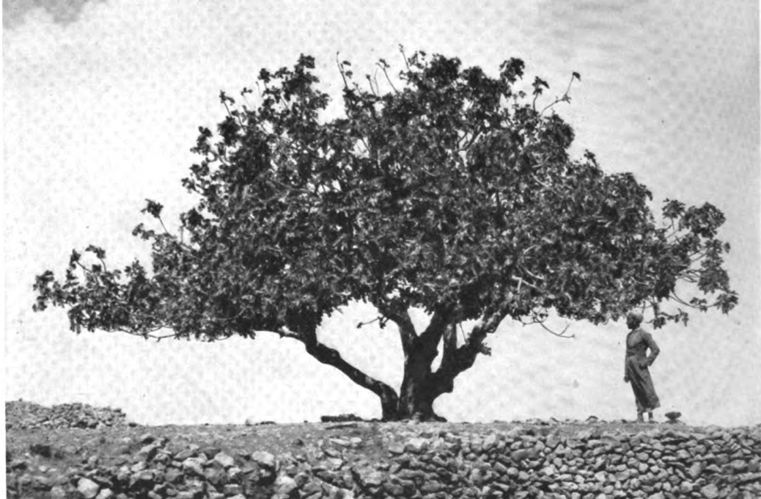
Locust Invasion: Before & After

Slide 25
a day of darkness and gloom, a day of clouds and thick darkness! Like blackness there is spread upon the mountains a great and powerful people; their like has never been before, nor will be again after them through the years of all generations.
Joel 2:2

Slide 26
Swarms of locusts had flown overhead in such thick clouds as to obscure the sun for the time being.
Whiting, 513

Slide 27
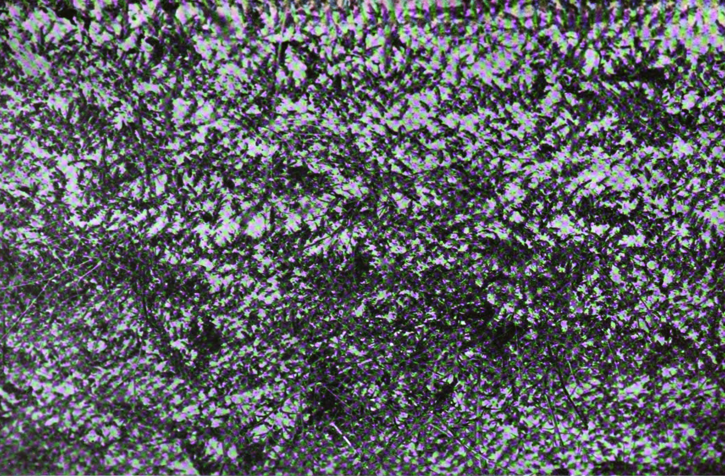

Slide 28
Their appearance is like the appearance of horses, and like war horses they run. As with the rumbling of chariots, they leap on the tops of the mountains, like the crackling of a flame of fire devouring the stubble, like a powerful army drawn up for battle.
Joel 2:4-5

Slide 29
However, before they were seen, a loud noise, produced by the flapping of myriads of locust wings, was heard, described as resembling the distant rumble of waves.
Whiting, 513

Slide 31
Before them peoples are in anguish; all faces grow pale.
Joel 2:6

Slide 32
A peasant woman on the plain of Sharon, during the locust pest, employed herself in trying to drive the creeping locusts out of her orchard. She took a tiny baby with her, and laying it in the shade of a tree, proceeded to her work. Returning shortly after, she found the child literally covered with the insects and its eyes already consumed out of the sockets.
Whiting, 547

Slide 33
Like warriors they charge; like soldiers they scale the wall. They march each on his way; they do not swerve from their paths. They do not jostle one another; each marches in his path; they burst through the weapons and are not halted. They leap upon the city, they run upon the walls, they climb up into the houses, they enter through the windows like a thief.
Joel 2:7-9

Slide 34
For three or four days an incessant and unending stream filled the road from side to side, like numberless troops marching on parade.
Whiting, 525

Slide 35
So that when anything neared their thickened masses it seemed as if the entire surface of the ground moved, producing a most curious effect upon one’s vision and causing dizziness, which in some was so severe as to produce a sensation not unlike seasickness.
Whiting, 525

Slide 36
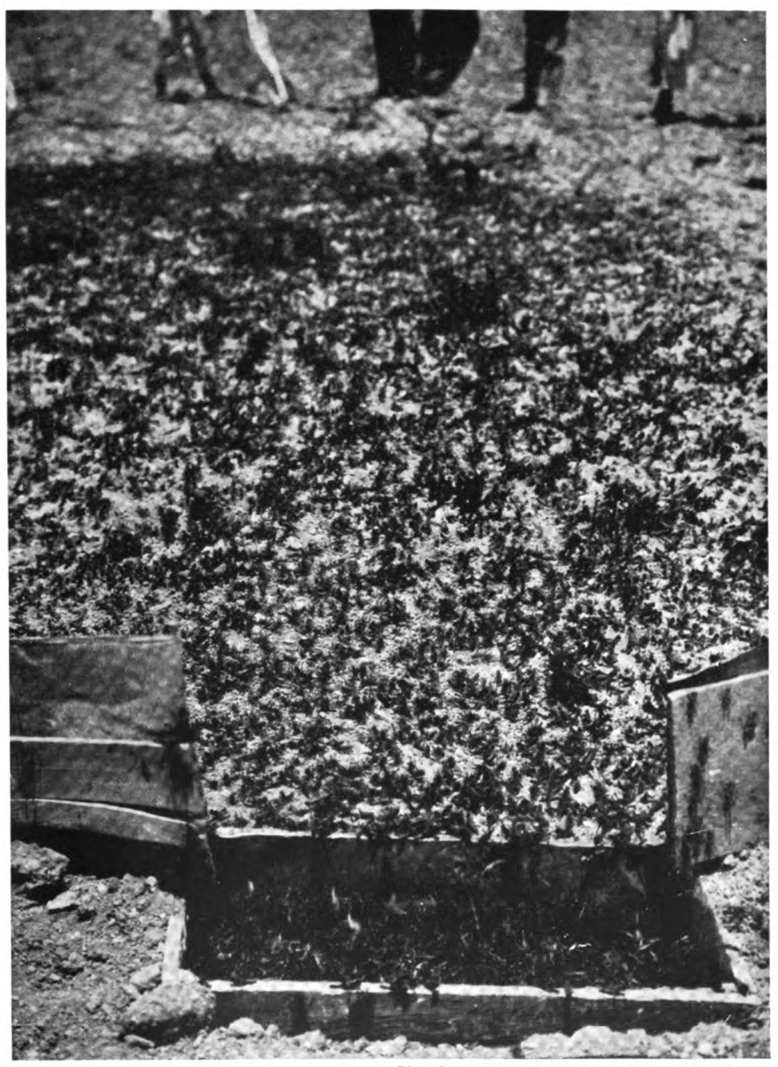

Slide 37
Up and up the city walls and the castle they climbed to their very heights.
Whiting, 526

Slide 38
Disastrous as they were in the country, equally obnoxious they became about the homes, crawling up thick upon the walls and, squeezing in through cracks of closed doors or windows, entering the very dwelling rooms.
Whiting, 533

Slide 39
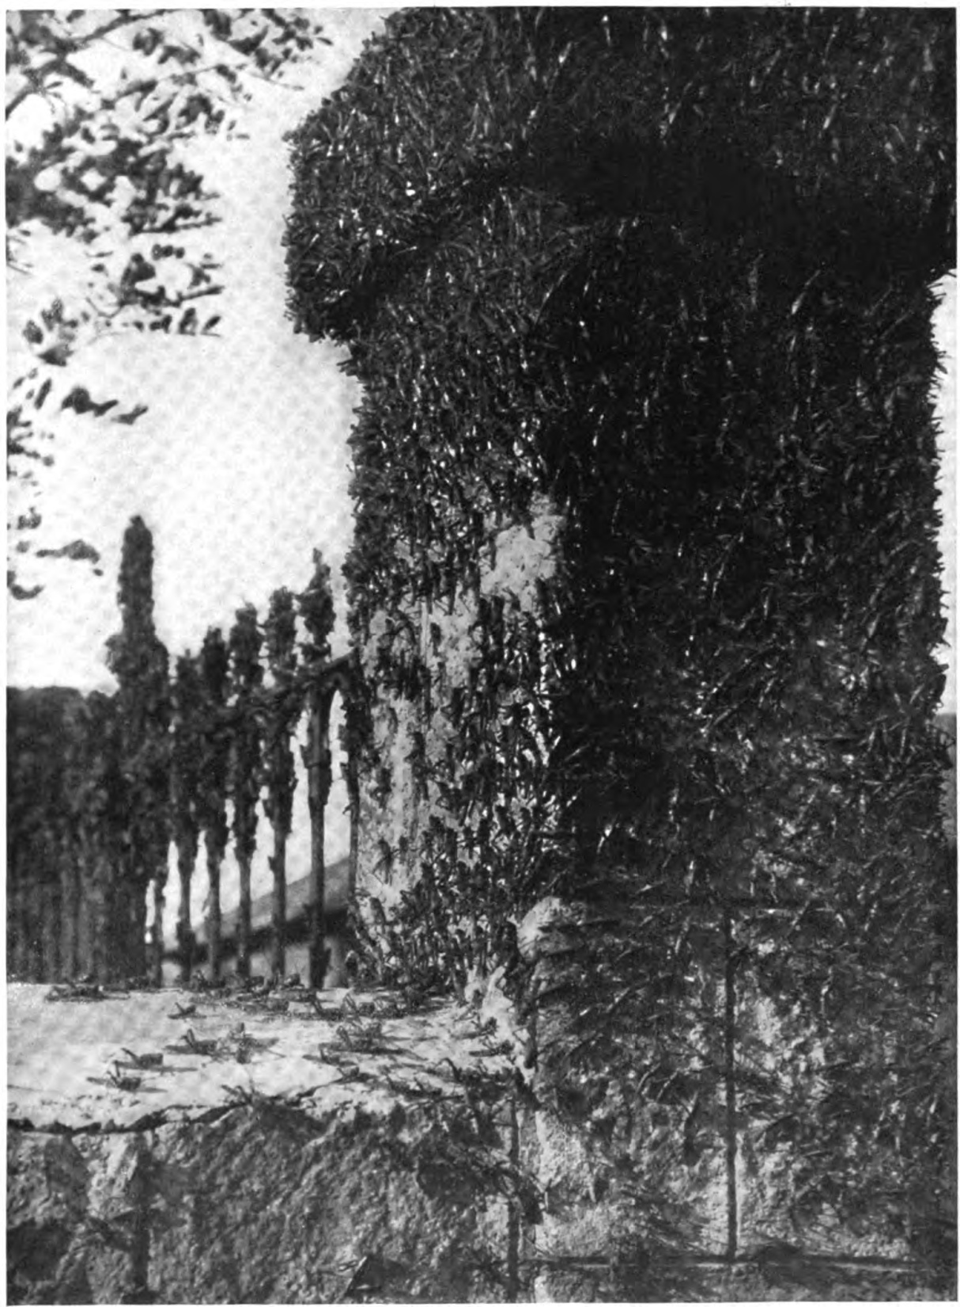

Slide 40
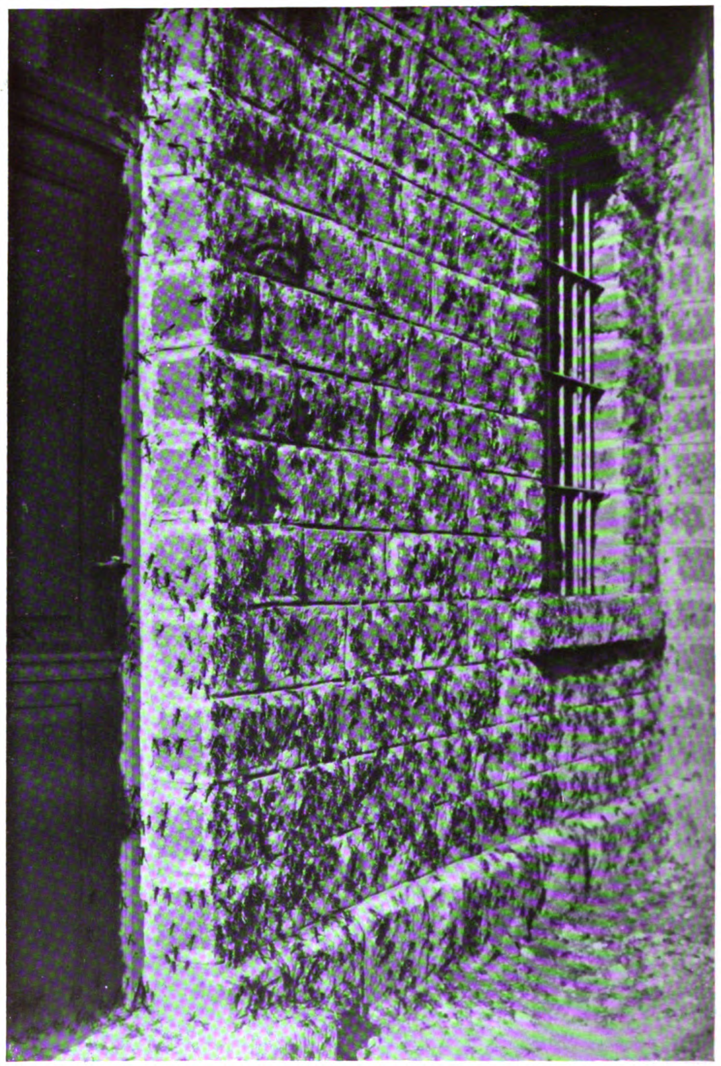

Slide 41
The LORD utters his voice before his army, for his camp is exceedingly great; he who executes his word is powerful. For the day of the LORD is great and very awesome; who can endure it?
Joel 2:11

Slide 42
It is interesting to note that the natives all speak of them as “Jaish Allah” (God’s army), they even finding the word “askar” (soldier) written in the Arabic characters upon the wings of the invading locusts.
Whiting, 535

Slide 43
